Slide 1
AIR CANVAS
TEAM DETAILS
S.MEGHNA PARVATHI : 21J41A66J4
M.VARSHA REDDY : 21J41A66G8
P.THARUN : 21J41A66J0
S.SAAKETH : 21J41A66J6
B.OM SWAROOP : 21J41A66D7

Slide 2
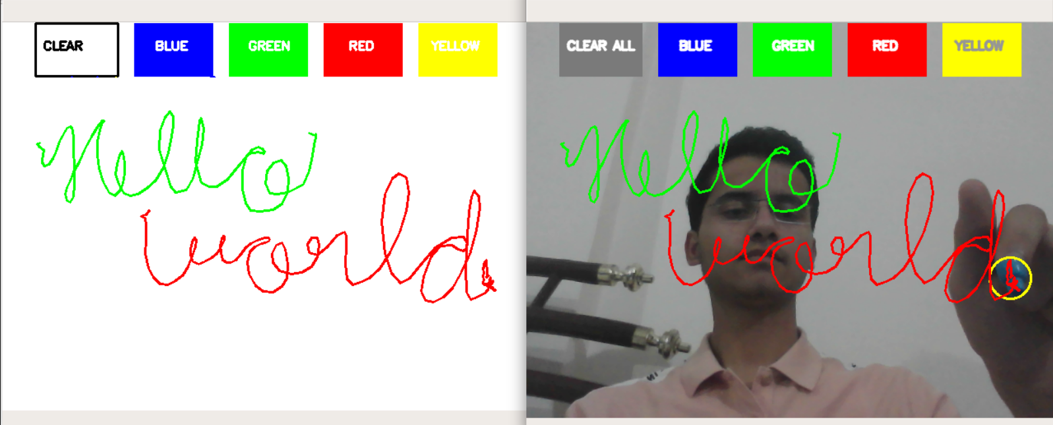
WHY AIR CANVAS ?
Air canvas help to draw on a screen by just waiving your finger.
The preferred language is python due to exhaustive libraries.
We use some machine learning algorithms to build source code.

Slide 3
ABSTRACT
Air Canvas is a hands-free digital drawing canvas that utilizes Picamera, and OpenCV to recognize and map hand gestures onto a screen. Writing in air has been one of the most fascinating and challenging research in field of image processing and pattern recognition. This project is a report of occasional gestures. It will use computer vision to trace the path of the finger. The project takes advantage of gap and focuses on developing a motion to-text converter that can potentially serve as software for intelligent wearable devices for writing from the air. The idea for Air Canvas was a result of our interest in digital drawing and smart photo recognition software. The idea for Air Canvas was a result of our interest in digital drawing and smart photo recognition software. Air Canvas is mainly used as a powerful means of communication for the deaf, which means implementing this project can help in many ways. For example An effective communication method that reduces mobile and laptop usage by eliminating the need to write. It also helps people with hearing impairments to communicate well. The project takes advantage of this gap and focuses on developing a motion - totext converter that can potentially serve as software for intelligent wearable devices for writing from the air.
Keywords:
Picamera , Opencv, Fascinating ,Gestures ,Intelligent.

Slide 4
OBJECTIVE AND SCOPE:
A powerful means of communication for the deaf, which means implementing this project can help in many ways.
An effective communication method that reduces mobile and laptop usage by eliminating the need to write.
It also helps people with hearing impairments to communicate well.
The project takes advantage of this gap and focuses on developing a motion-to-text converter that can potentially serve as software for intelligent wearable devices for writing from the air.

Slide 5
HARDWARE AND SOFTWARE REQUIREMENTS
HARDWARE:
Processer(i5 or i7)
Monitor(PC)
Webcam
Libraries are Numpy
Open cv, Media pipe
SOFTWARE:
OS(Windows 7,8,10,11 Any OS)
Python3
Vscode

Slide 6
THANK YOU

